Slide 1
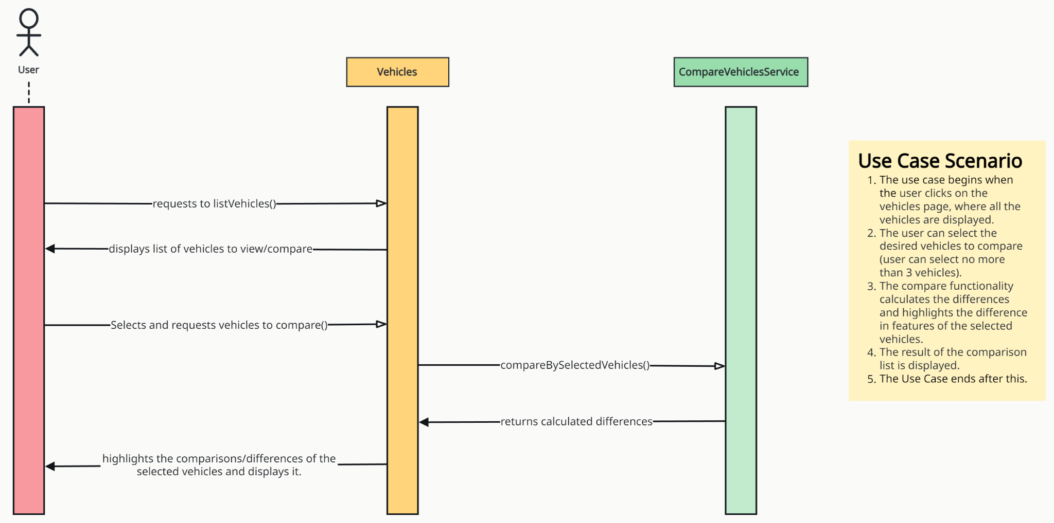
Sequence Diagram - Team 1
User Story: 02.02 Compare Vehicles

Slide 2
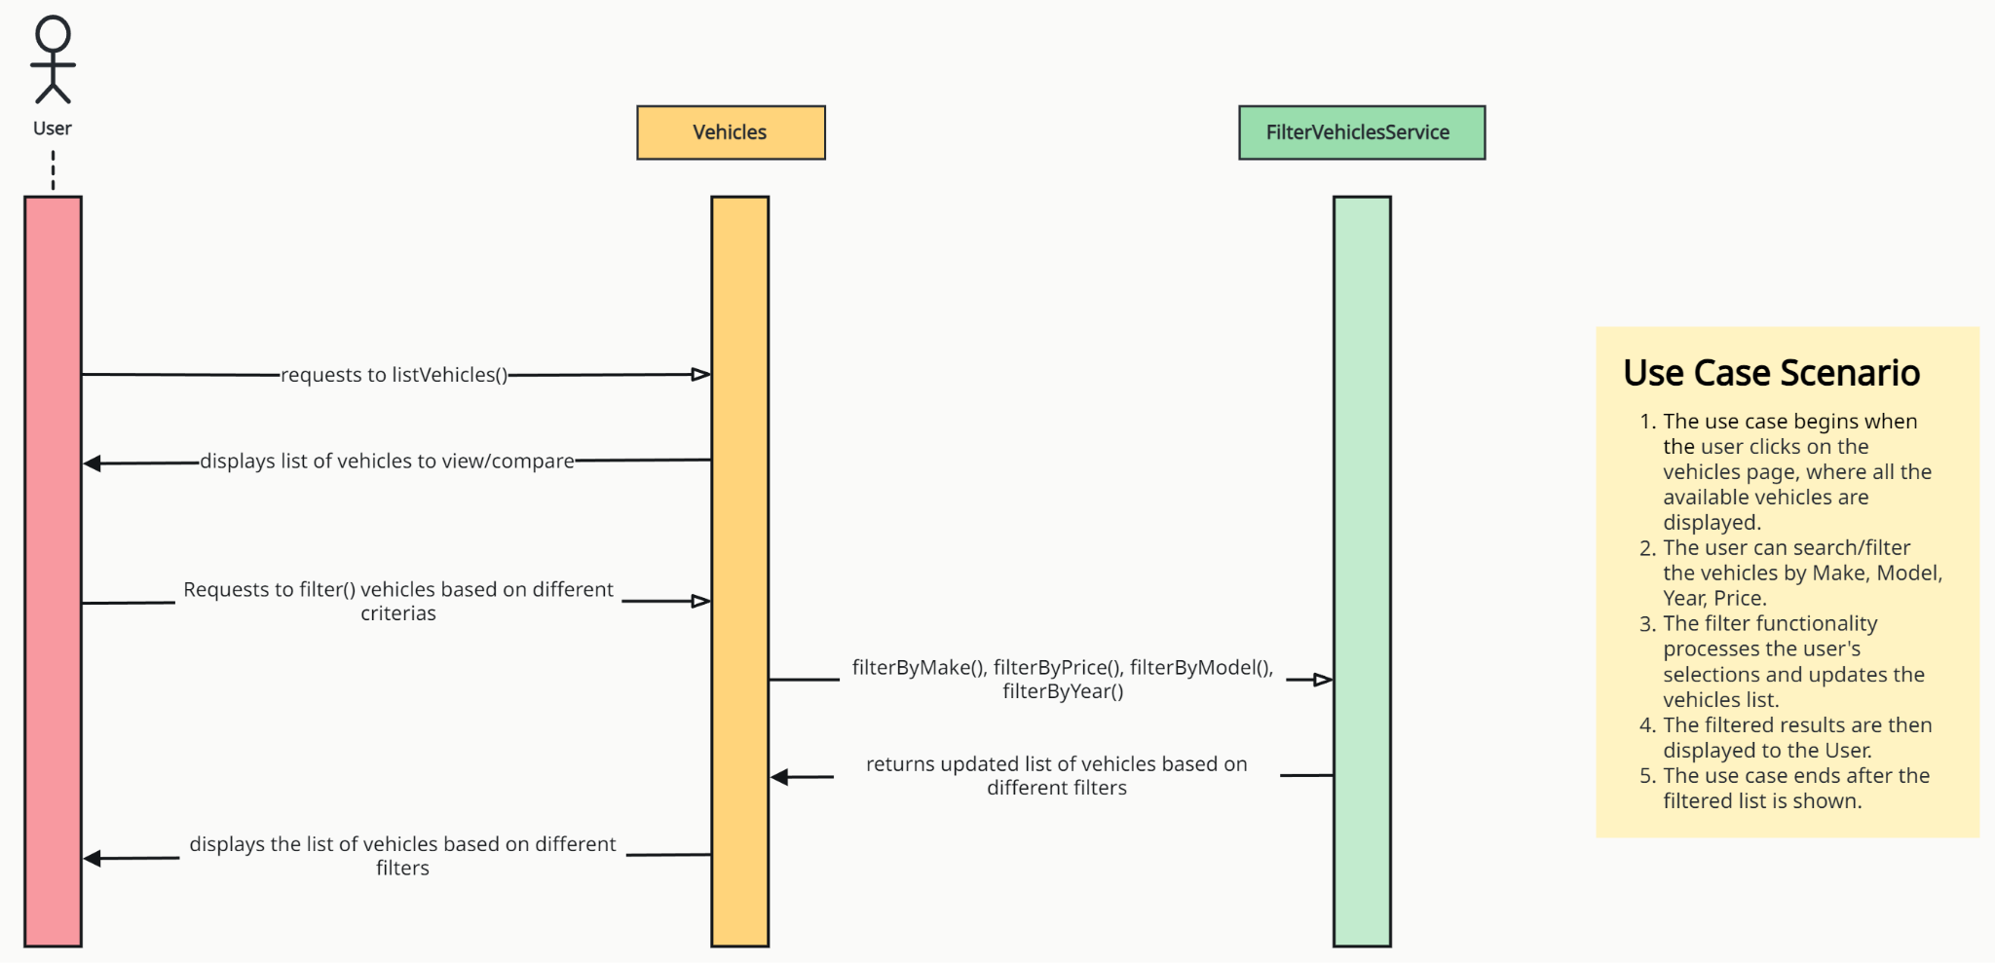
Sequence Diagram - Team 1
User Story: 02.03 Filter Vehicles

Slide 3
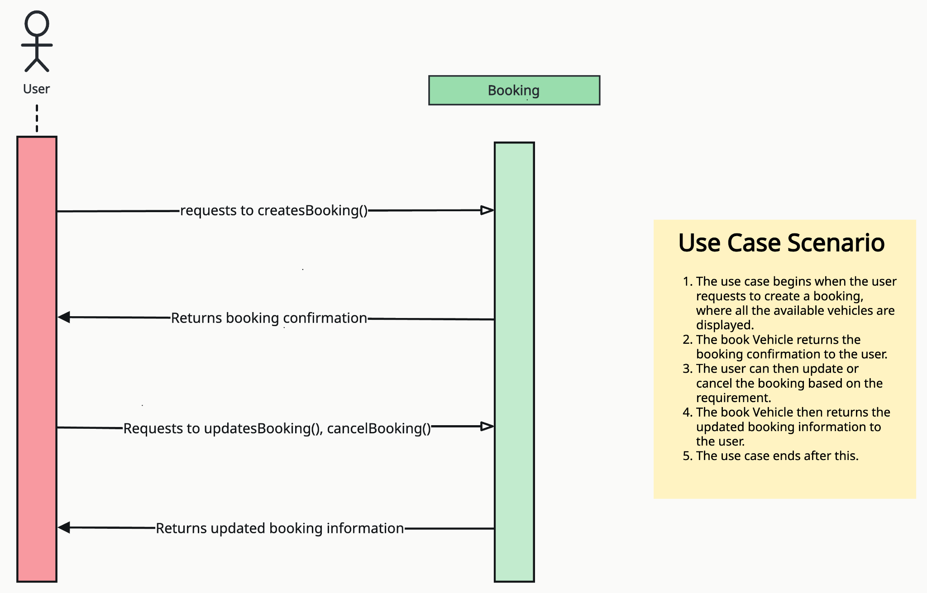
Sequence Diagram - Team 1
User Story: 03.01 Book Vehicles

Slide 4
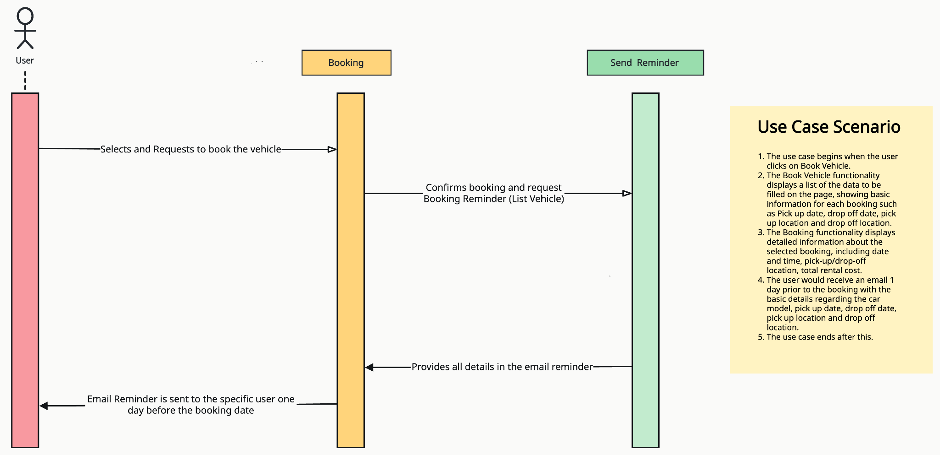
Sequence Diagram - Team 1
User Story: 03.02 Send Booking Reminder

Slide 5
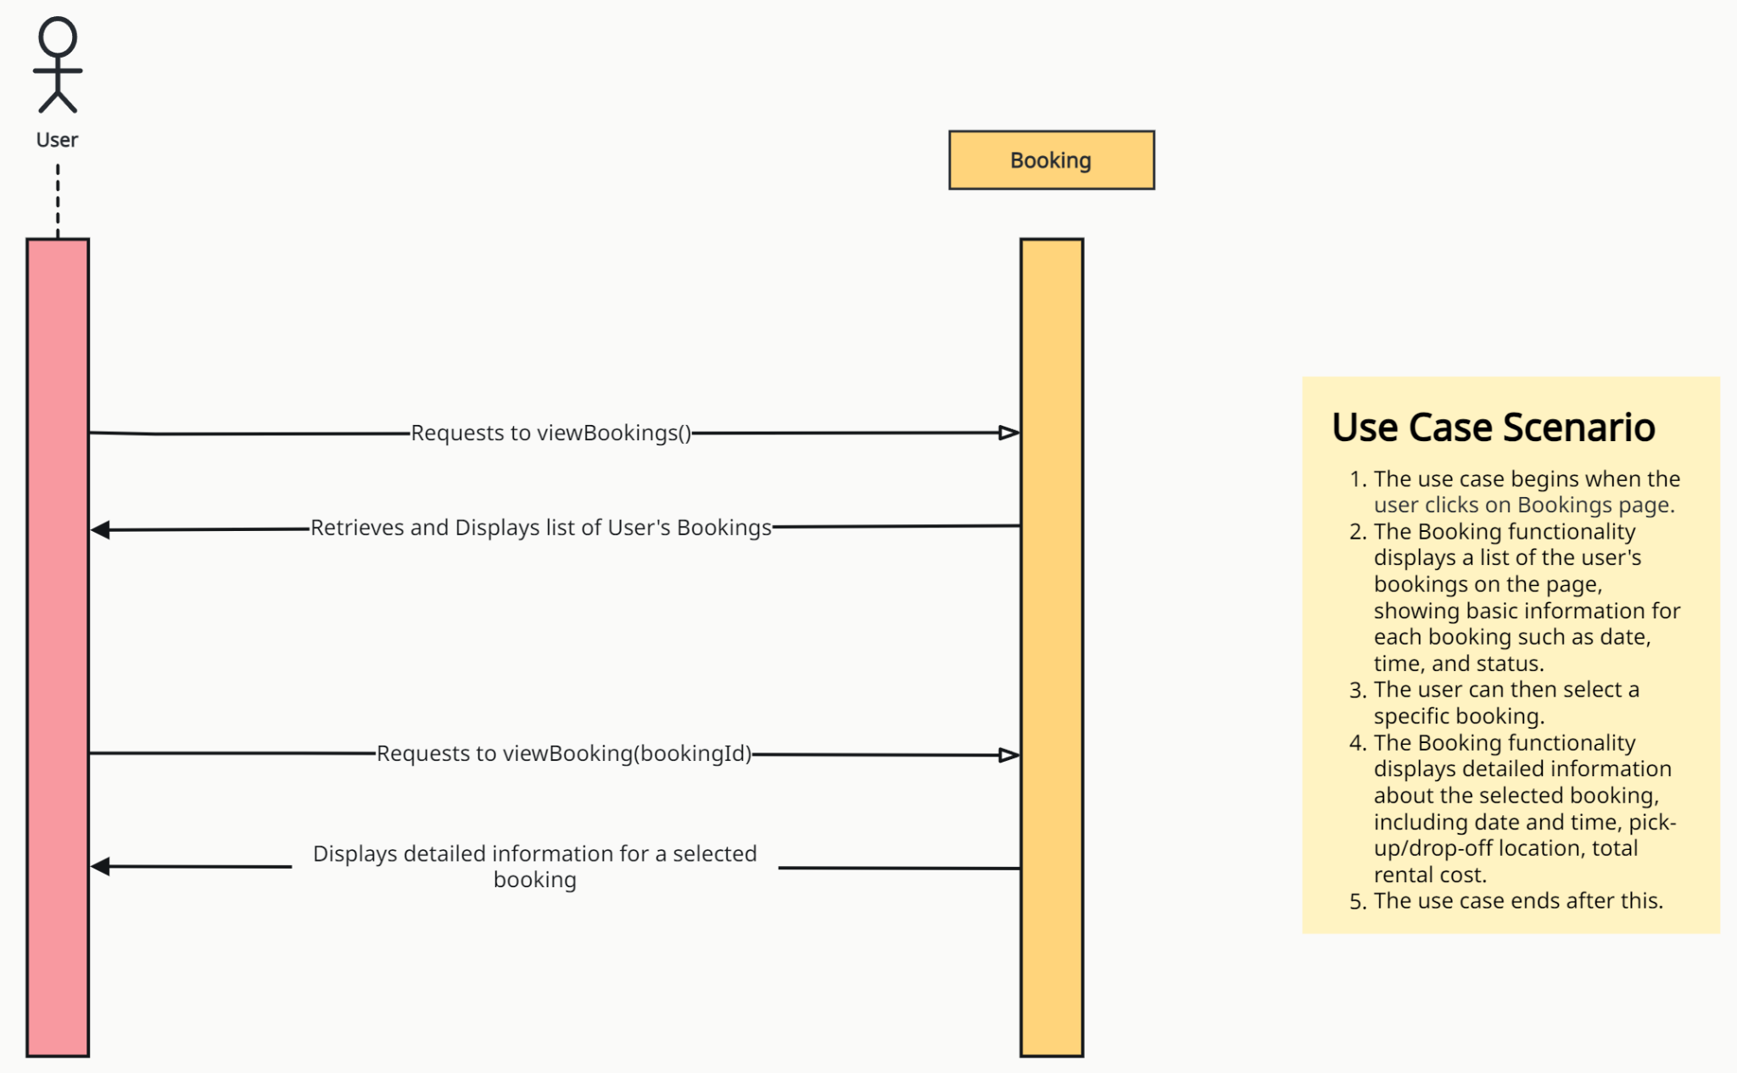
Sequence Diagram - Team 1
User Story: 03.04 View Bookings

